Slide 1


DSCI 2710 ‒ Lecture 6 UNTDBS Lessons 5.1-5.2
Classical Probability
Slide Material from: Nottingham & Hawkes, Discovering Business Statistics

Slide 2
Objectives
Identify the sample space of a probability event.
Calculate basic probabilities.
Determine if two events are mutually exclusive.
Determine if two events are independent.
Use the counting principle to determine the number of outcomes in an experiment
Define factorials
Define Permutations and Combinations
Define the laws of probability
Compute probabilities on a contingency table

Slide 3
Introduction to Probability
A probability experiment (or trial) is any process with a result determined by chance.
Each individual result that is possible for a probability experiment is an outcome.
The sample space is the set of all possible outcomes for a given probability experiment.
An event is a subset of outcomes from the sample space.

Slide 4
Introduction to Probability
Examples of probability experiments include:
flipping a coin
tossing a pair of dice
drawing a raffle ticket
In each of theses examples, there is more than one possible result and that result is determined at random.

Slide 5
Example 4.1: Identifying Outcomes in a Sample Space or Event
Consider an experiment in which a coin is tossed and then a six-sided die is rolled.
a. List the outcomes in the sample space for the experiment.
b. List the outcomes in the event “tossing a tail then rolling an odd number.”

Slide 6
Example 4.1: Identifying Outcomes in a Sample Space or Event (cont.)
Solution
a. Each outcome consists of a coin toss and a die roll. For example, heads and a 3 could be denoted as H3. Using this notation, the sample space can be written as follows.

Slide 7
Example 4.1: Identifying Outcomes in a Sample Space or Event (cont.)
b. Choosing the members of the sample space that fit the event “tossing a tail then rolling an odd number” gives the following.

Slide 8
Example 4.2: Using a Pattern to List All Outcomes in a Sample Space
Consider the experiment in which a red six-sided die and a blue six-sided die are rolled together.
a. Use a pattern to help list the outcomes in the sample space.
b. List the outcomes in the event “the sum of the numbers rolled on the two dice equals 6.”

Slide 9
Example 4.2: Using a Pattern to List All Outcomes in a Sample Space (cont.)
Solution
a. Although there are many patterns that could help us list all outcomes in the sample space, our pattern will be to start with keeping the red die at 1, and allowing the blue die to vary from 1 to 6.

Slide 10


Example 4.2: Using a Pattern to List All Outcomes in a Sample Space (cont.)
There are six of these outcomes:
and .
Next we list all outcomes in which a 2 is rolled on the red die. Again, there are six outcomes of this form. The pattern continues until all 36 outcomes are listed.

Slide 11
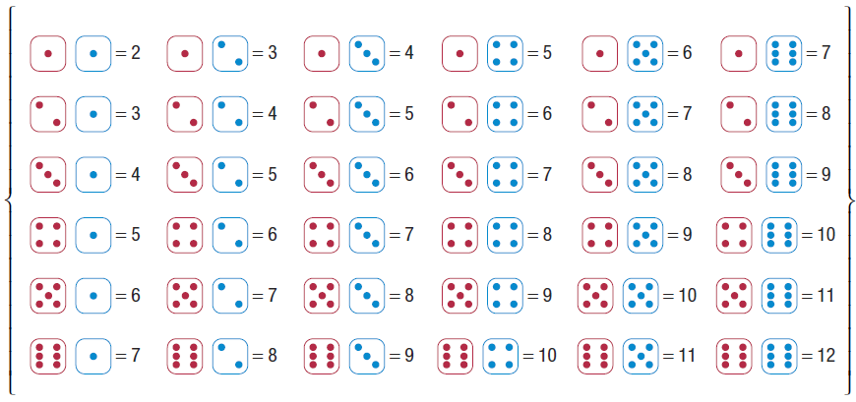
Example 4.2: Using a Pattern to List All Outcomes in a Sample Space (cont.)
Sample space =

Slide 12


Example 4.2: Using a Pattern to List All Outcomes in a Sample Space (cont.)
Note that rolling a 1 on the red die and a 2 on the blue
die, denoted , is a different outcome than
rolling a 2 on the red die and a 1 on the blue die,
denoted .

Slide 13
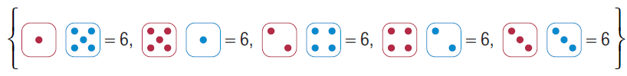
Example 4.2: Using a Pattern to List All Outcomes in a Sample Space (cont.)
b. To list the outcomes in the event “the sum of the numbers rolled on the two dice equals 6,” look through the list above for each individual outcome where the sum equals 6. Note that 1 + 5 = 6, so the outcome of rolling a 1 on the red die and a 5 on the blue die is in the event. The reverse would be rolling a 5 on the red die and a 1 on the blue die. These are two separate possible outcomes that are both in the event. The event consists of the following outcomes.

Slide 14
Using a Tree Diagram to List All Outcomes in a Sample Space
A tree diagram can be used to represent the outcomes of an experiment when the experiment consists of several stages. The tree begins with the possible outcomes for the first stage and then branches for each additional possibility. Each of the elements of the last row of the tree diagram represents a unique outcome in the sample space. The number of possibilities in the bottom row of the tree is equal to the number of outcomes in the sample space.

Slide 15
Example 4.3: Using a Tree Diagram to List All Outcomes in a Sample Space
Consider a family with three children. Use a tree diagram to find the sample space for the gender of each child in regard to birth order.
Solution
The tree begins with the two possibilities for the first child—girl or boy. It then branches for each of the other two births in the family as shown.

Slide 16
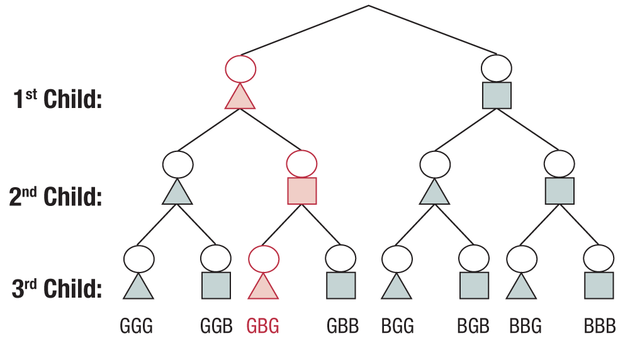
Example 4.3: Using a Tree Diagram to List All Outcomes in a Sample Space (cont.)
=Girl
=Boy
Key: The notation GBG indicates the family shown in red with a girl, then a boy, and finally a girl.

Slide 17
Example 4.3: Using a Tree Diagram to List All Outcomes in a Sample Space (cont.)
Using the tree diagram as a guide, the sample space can be written as follows.

Slide 18
Calculating Probability
There are three methods for calculating the probability of an outcome:
subjective probability
experimental probability
classical probability

Slide 19
Calculating Probability
Subjective Probability
Subjective probability, is simply an educated guess regarding the chance that an event will occur. It is the least precise type of probability.
An example of subjective probability is when the local weatherman says there is a 90% chance of rain today. Subjective probability is only as good as the expertise of the person giving the probability.

Slide 20
Calculating Probability
Experimental Probability
In experimental probability, if E is an event, then P(E), read “the probability that E occurs,” is given by
where f is the frequency of event E and
n is the total number of times the experiment is performed.
Experimental probability is also known as empirical probability.

Slide 21
Calculating Probability
Law of Large Numbers
The Law of Large Numbers says that the greater the number of trials, the closer the experimental probability will be to the true probability.
Note that a probability may be written as a fraction, decimal, or percentage.

Slide 22
Calculating Probability
Classical Probability
In classical probability, if all outcomes are equally likely to occur, then P(E), read “the probability that E occurs,” is given by
where n(E) is the number of outcomes in the event and
n(S) is the number of outcomes in the sample space.
Classical probability, also called theoretical probability, is the most precise type of probability. Its computation is based on counting rules.

Slide 23
Types of Probability
Subjective probability is an educated guess regarding the chance that an event will occur.
Experimental probability (or empirical probability) uses the outcomes obtained by repeatedly performing an experiment to calculate the probability.
Classical probability (or theoretical probability) is the most precise type of probability and can only be calculated when all possible outcomes in the sample space are known and equally likely to occur.

Slide 24
Example 4.4: Identifying Types of Probability
Determine whether each probability is subjective, experimental, or classical.
a. The probability of selecting the queen of spades out
of a well-shuffled standard deck of cards is
b. An economist predicts a 20% chance that technology stocks will decrease in value over the next year.

Slide 25
Example 4.4: Identifying Types of Probability (cont.)
c. A police officer wishes to know the probability that a driver chosen at random will be driving under the influence of alcohol on a Friday night. At a roadblock, he records the number of drivers stopped and the number of drivers driving with a blood alcohol level over the legal limit. He determines that the probability is 3%.

Slide 26
Example 4.4: Identifying Types of Probability (cont.)
Solution
a. All 52 outcomes are known and are equally likely to occur, so this is an example of classical probability.
b. The economist is giving an educated guess; therefore, this is an example of subjective probability.
c. The police officer’s probability is based on the evidence gathered from the roadblock. Because not all drivers were evaluated at that roadblock, the probability is experimental.

Slide 27
Example 4.5: Calculating Classical Probability
Beck is allergic to peanuts. At a large dinner party one evening, he notices that the cheesecake options on the dessert table contain the following flavors: 10 slices of chocolate, 12 slices of caramel, 12 slices of peanut butter chocolate, and 8 slices of strawberry. Assume that the desserts are served to guests at random.
a. What is the probability that Beck’s cheesecake contains peanuts?
b. What is the probability that Beck’s dessert does not contain chocolate?

Slide 28
Example 4.5: Calculating Classical Probability (cont.)
Solution
a. There are 12 slices of chocolate peanut butter cheesecake, and 10 + 12 + 12 + 8 = 42 pieces of cheesecake total. The probability is then calculated as follows.

Slide 29
Example 4.5: Calculating Classical Probability (cont.)
b. There are 12 + 8 = 20 slices of cheesecake that do not contain chocolate. The probability of being served one of these desserts is calculated as follows.

Slide 30
Example 4.6: Calculating Classical Probability
Consider a beginning archer who only manages to hit the target 50% of the time. What is the probability that in three shots, the archer will hit the target all three times?
Solution
For each shot, the arrow will either hit the target or miss the target. Note that these two outcomes are equally likely here since his chance of hitting the target is 50%. To determine how many outcomes are in the sample space, we can use either a pattern or a tree diagram.

Slide 31
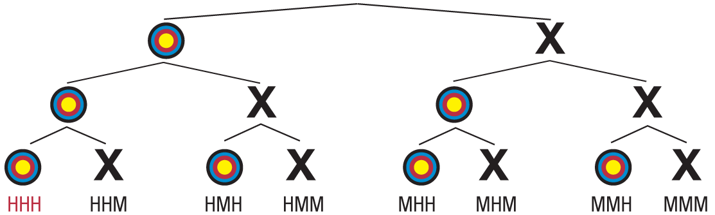
Example 4.6: Calculating Classical Probability (cont.)
Let’s use a tree diagram.

Slide 32
Example 4.6: Calculating Classical Probability (cont.)
Notice that this gives 8 possible outcomes for the three shots, only 1 of which consists of hitting the target all three times. Thus, the probability of the novice archer hitting the target three times in a row is calculated as follows.

Slide 33
Example 4.7: Calculating Classical Probability
Consider a family with six boys. What is the probability that the seventh child will also be a boy?
Solution
Many people would say that this family is due to have a girl, but let’s consider the mathematics. Suppose we took the time to write down every possible combination for birth orders of seven children. Because the family already has six boys, we would have to mark out all combinations that contain a girl in the first six children.

Slide 34
Example 4.7: Calculating Classical Probability (cont.)
The only two outcomes left in the sample space would be BBBBBBG and BBBBBBB. The probability of baby number seven being a boy is then
just as with any other pregnancy!

Slide 35
Example 4.8: Calculating Classical Probability
In biology, we learn that many diseases are genetic. One example of such a disease is Huntington’s disease, which causes neurological disorders as a person ages. Each person has two Huntington genes—one inherited from each parent. If an individual inherits a mutated Huntington gene from either of his or her parents, he or she will develop the disease. On the TV show House, the character who Dr. House calls “13” inherited this disease from her mother. Assume for a moment that “13” has a child with a person who has two healthy Huntington genes. What is the probability that her child will develop Huntington’s disease?

Slide 36
Example 4.8: Calculating Classical Probability (cont.)
Solution
So far, we have listed the outcomes of an experiment in an orderly fashion and by using a tree diagram. In biology, we commonly use a Punnett square to help list the outcomes of a genetic experiment. The mother’s two alleles of a specific gene are listed along one side of a square, and the father’s two alleles of the gene are listed along an adjacent side. We then fill in the square by writing in the four possible combinations of alleles inherited—one from each parent.

Slide 37
Example 4.8: Calculating Classical Probability (cont.)
For this experiment, we know that each person has two Huntington genes. We will label a mutated Huntington gene with an uppercase “H” and an unaffected Huntington gene with a lowercase “h.” For this experiment, the mother has at least one mutated gene.
Let’s assume it is just one, so her genetic makeup would be written as Hh. She has a child with someone who has no affected Huntington genes, so his genetic makeup can be written as hh. Let’s write these gene combinations on the sides of a Punnett square.

Slide 38
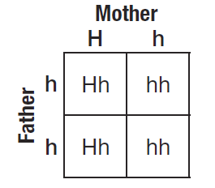
Example 4.8: Calculating Classical Probability (cont.)
So the four possibilities for the child’s genes are
{Hh, Hh, hh, hh}. Someone only has to
have one mutated gene to develop the
disease, so that means two of the four
combinations would result in a child
having the disease, {Hh, Hh}. Thus, if
E = the event of the child inheriting
a mutated Huntington gene, then the probability that E occurs is calculated as follows.

Slide 39
Example 4.8: Calculating Classical Probability (cont.)
This means that “13” has a 50% chance of passing on the disease to a child. This is true for anyone with Huntington’s disease. The probability goes up if the other parent also has the disease.

Slide 40
Laws of Probability
Probability Law 1
A probability of zero means the event cannot happen.
Probability Law 2
A probability of one means the event must happen.
Probability Law 3
All probabilities must be between zero and one inclusively. That is,

Slide 41
Laws of Probability
Probability Law 4
The sum of the probabilities of all outcomes in a sample space must equal one. That is, if P(A_{i}) is the probability of outcome A_{i} , and there are n such outcomes, then

Slide 42
Laws of Probability
Definition
The union of the events A and B is the set of outcomes that are included in A or B or both, and is denoted A∪B. The union is depicted graphically in the Venn diagram below.
A
B
A∪B

Slide 43
Laws of Probability
Definition
The intersection of the events A and B is the set of all outcomes that are included in both A and B. Symbolically, the intersection of A and B is denoted A∩B and is read “A intersect B.”
A
B
A∩B

Slide 44
Conditional Probability
Definition
The probability that one event will occur given that some other event has occurred is a conditional probability.
The conditional probability of A, given that B has occurred, is

Slide 45
Laws of Probability
Probability Law 5
The probability of the complement of A, A^{c}, is given by P(A^{c}) = 1− P(A)
Probability Law 6
Union of Mutually Exclusive Events
If the events A and B are mutually exclusive, then
A
B

Slide 46
Laws of Probability
Probability Law 7
Intersection of Mutually Exclusive Events
If the events A and B are mutually exclusive, then
A
B

Slide 47
Example 5.7
Suppose P(A) = 0.27 and P(B) = 0.19. If A and B are mutually exclusive, what is the probability of A∪B?
Solution
Since these are mutually exclusive events,

Slide 48
Laws of Probability
Probability Law 8
The Addition Rule:
For any two events A and B,
A
B
Subtract this area so that you do not double-count it

Slide 49
Conditional Probability and Independence
Probability Law 9
The conditional probability of A, given that B has occurred, is
Definition
Two events A and B are independent when the conditional probability of A, given that B has occurred, is equal to the probability of A.
If P(A|B) = P(A), then A and B are independent

Slide 50
Example 5.8
Suppose that the marketing manager mentioned earlier believed that the probability that someone earns more than $50,000 is 0.2 and the probability that someone will subscribe to more than one sports magazine is 0.3. If the probability of finding someone in both categories is 0.08, what is the probability of finding someone who is earning over $50,000 or subscribes to more than one sports magazine, or both?

Slide 51
Example 5.8 (cont.)
Solution
The problem involves the union of two events. Using the same event names (A and B) as in previous examples, the desired probability is
Therefore, the probability of finding someone who is earning over $50,000 or subscribes to more than one sports magazine, or both is 0.42.

Slide 52
Contingency Tables (cross-tabulations)
A contingency table (aka cross-tabulation), is a breakdown of a total count (=grand total) into individual counts that correspond to compound events, also showing row totals and column totals
Age | Agree | Disagree | Total
Age group 1 | 50 | 50 | 100
Age group 2 | 20 | 60 | 80
Total | 70 | 110 | 180
Row totals
Column totals
Grand total

Slide 53
Example 5.9
Suppose a marketing research firm has surveyed 1403 consumers to test a new product and produced the following cross tabulation indicating the number of panelists that liked the product, the number that did not like the product, and the number that were undecided.
Table 5.1 – Market Research Survey
Age Like Not Like Undecided Total
18–35 213 197 103 513 35–50 193 184 67 444 Over 50 144 219 83 446
Total 550 600 253 1403

Slide 54
Contingency table: Marginal (simple) probability
Suppose we pick one of the 1403 participants at random. The probability that the participant is “over 50” is P(over 50) = row total/grand total = 446/1403. Notice that both numbers are on the margin of the table; that’s why simple probabilities are also called “marginal”.
Age Like Not Like Undecided Total
18–35 213 197 103 513 35–50 193 184 67 444 Over 50 144 219 83 446
Total 550 600 253 1403

Slide 55
Contingency table: Conditional probability
Suppose we pick one of the 1403 participants at random. The conditional probability that the participant “likes” the product given that the participant is “over 50” is P(“likes”|“over 50”) = cell entry/row total = 144/446
Age Like Not Like Undecided Total
18–35 213 197 103 513 35–50 193 184 67 444 Over 50 144 219 83 446
Total 550 600 253 1403

Slide 56
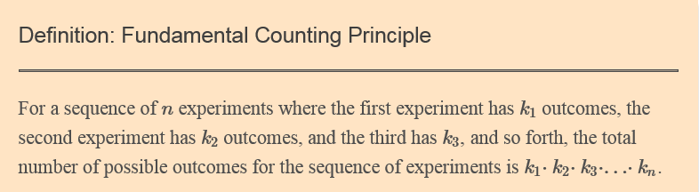
Fundamental Counting Principle
You can multiply together the number of possible outcomes for each stage in an experiment in order to obtain the total number of outcomes for that experiment. See HLS Lesson 4.3 for more details.

Slide 57
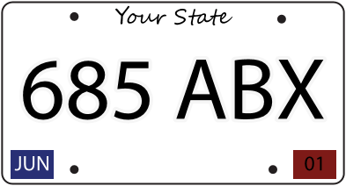
Example 1
How many different car license plates are possible if a license plate consists of three numbers followed by three letters of the alphabet?

Slide 58
Example 1
Solution:
There are 6​ slots to fill – 3​ are for the numbers and 3​ are for the letters. A typical plate would look something like the image above.
Each of the first 3​ slots has 10​ different choices (the digits 0–9​). Each of the last 3​ slots has 26​ different choices (the 26​ letters in the alphabet.) Thus, by the Fundamental Counting Principle the total number of plates possible is
10⋅10⋅10⋅26⋅26⋅26=17,576,000.​

Slide 59
Factorials
Solution:
The factorial of an integer n (denoted n!) is the product of all positive integers less than or equal to n.​ Symbolically, factorials are written as
n! = n(n−1)(n−2)⋯(2)(1).
Note: By definition, 0!=1.​

Slide 60
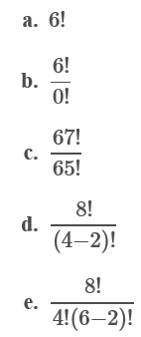
Examples
Calculate the following expressions:

Slide 61




Examples
Solutions:
a. 6!=(6)(5)(4)(3)(2)(1)=720
b.
c.
d.
e.

Slide 62
Permutations and Combinations
When you are looking to count the number of ways objects can be chosen out of a group, then the problem you are dealing with is either a permutation or a combination. The way that you distinguish between the two calculations is that for a permutation, the order in which the objects are chosen is important.
When the order in which the objects are chosen is not important, then we use a combination.

Slide 63


Permutation and Combination Formulas
The Number of n​ Distinct Objects Taken r​ at a Time,
When order is important:
Permutations: nPr = $\frac{n!}{\left(n−r\right)!}$
The Number of n​ Distinct Objects Taken r​ at a Time,
When order is not important:
Combinations: nCr = $\frac{n!}{r!\left(n−r\right)!}$

Slide 64
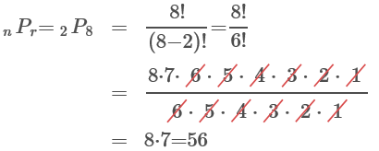
Examples
Example 1. For a committee of 8​ people, how many ways can a chairperson and a secretary be selected from amongst its members?
Solution: First note that the order of the members chosen is important, i.e., it is different if someone is elected for chairperson rather than secretary. Therefore, this is a permutation with n=8, r=2.

Slide 65
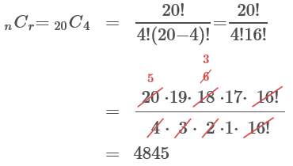
Examples
Example 2. How many ways can four people be chosen from a group of twenty to serve on a committee?
Solution: Since there is no ranking in the committee, order does not matter. Therefore, this is a combination problem with n=20, r=4 (4 people are chosen out of 20).

Slide 66
HLS UNTDBS Lesson 5.1

Slide 67

HLS UNTDBS Lesson 5.1: Sample questions
There are 330 identical plastic chips numbered 1 through 330 in a box. What is the probability of reaching into the box and randomly drawing a chip number that is smaller than 222? Express your answer as a simplified fraction or a decimal rounded to four decimal places.
Solution: $\frac{221}{330}$ = 0.6697

Slide 68

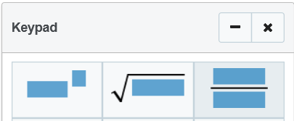


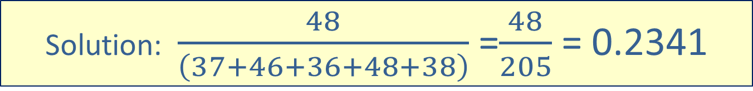
HLS UNTDBS Lesson 5.1: Sample questions
You decide to record the hair colors of people leaving a lecture at your school. What is the probability that the next person who leaves the lecture will have black hair? Express your answer as a simplified fraction or a decimal rounded to four decimal places.
Solution: $\frac{48}{\left(37+46+36+48+38\right)}$ =$\frac{48}{205}$ = 0.2341

Slide 69
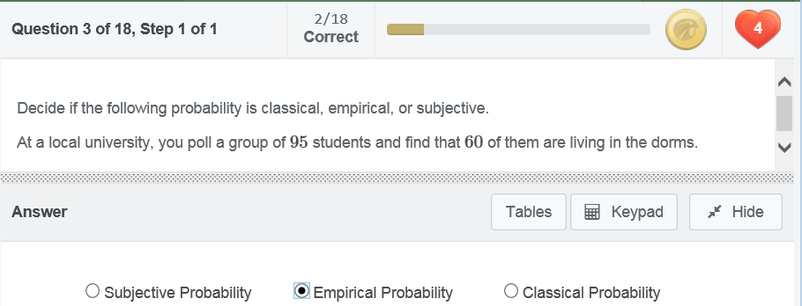
HLS UNTDBS Lesson 5.1: Sample questions

Slide 70
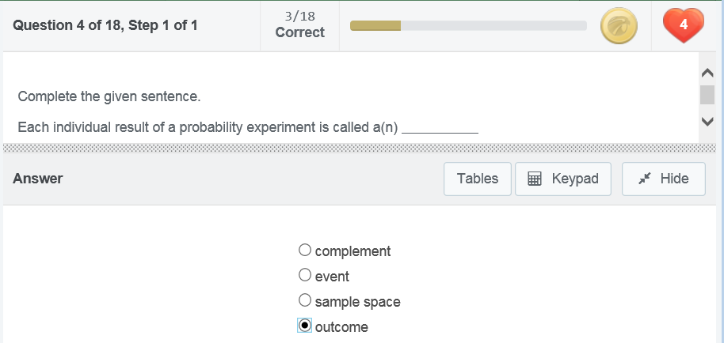
HLS UNTDBS Lesson 5.1: Sample questions

